Slide 1
Background Tasks

Slide 2
What problems do Background Jobs solve ?
Do recurring tasks every X minutes.
Send email every X minutes.
Check for database every X minutes.
Delete old entries in database every X minutes.
Perform CPU intensive work asynchronously like generating PDF(s) / images.

Slide 3
Hosting in .NET core
All ASP .NET core applications can be hosted in 2 ways –
In process
Out of process

Slide 4
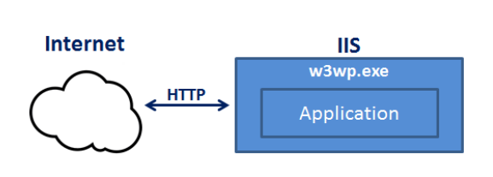
In process hosting
In-process hosting runs an ASP.NET Core app in the same process as its IIS worker process.
It is the default hosting model in ASP .NET Core applications.
.NET 6 WebApplication.CreateBuilder method calls UseIIS() method underneath to host the app inside IIS.
If running locally in Visual Studio the IIS worker process is iisexpress.exe
If deployed in IIS, it is w3wp.exe

Slide 5
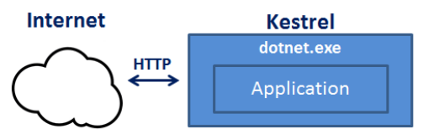
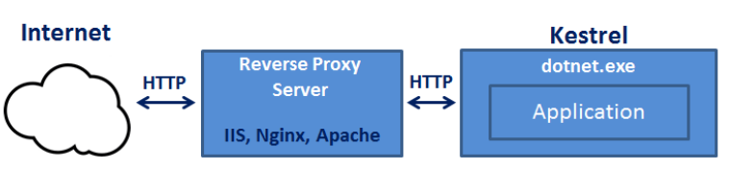
Out of process hosting
There are 2 web servers internal and external hosted by the console application process dotnet.exe
Internal is kestrel which can be directly used.
External ones include IIS, NGINX, Apache, etc.

Slide 6
Available options for background processing
Quartz.NET (Java port of popular scheduling library)
Hangfire (Full featured library for background processing with interactive dashboards, free for commercial use but support is charged between $500-$4500 / yr)
ASP .NET Core Hosted Services.
ASP .NET Core Background Services.

Slide 7
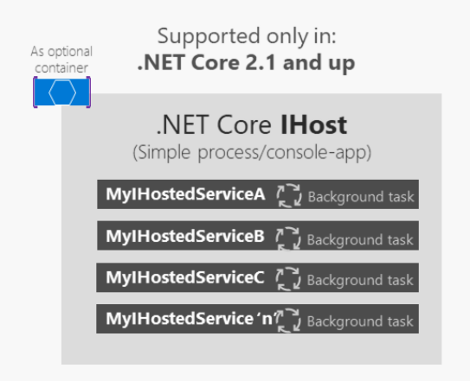
Hosted Services .NET Core
Is a class implementing IHostedService interface mainly used for long running background tasks.
Implementing class should implement these two methods –
StartAsync(CancellationToken token);
StopAsync(CancellationToken token);

Slide 8
Can exist with MVC / API app or can be used with Worker Service Visual studio template.
Hosted Services run independently of the .NET core request HttpContext on a Threadpool thread.
Can be registered in the IoC container using the Services.AddHostedService<T>() method.

Slide 9
StartAsync -
Called when the server is bootstrapped (IApplicationLifetime.ApplicationStarted).
StartAsync can block the rest of your server from starting.
Don’t perform long running work in StartAsync (Exceptions are database migrations).
Infinite task running under the while loop in StartAsync will never launch the .NET Core IHost as the server relies all hosted services StartAsync to finish executing first.
Without blocking the web application from launching we can run the StartAsync is using –
Task.Run factory method to set off a separate task in the threadpool.
Using C# 7 discards.

Slide 10
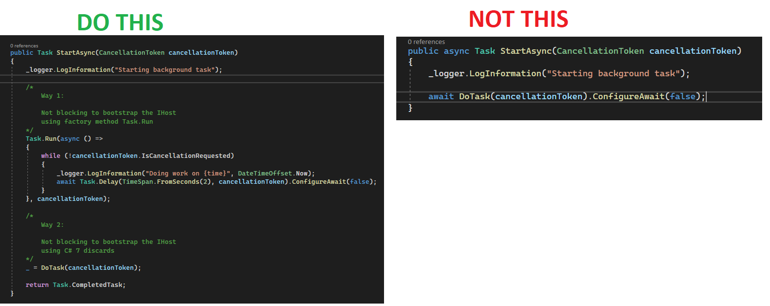

Slide 11
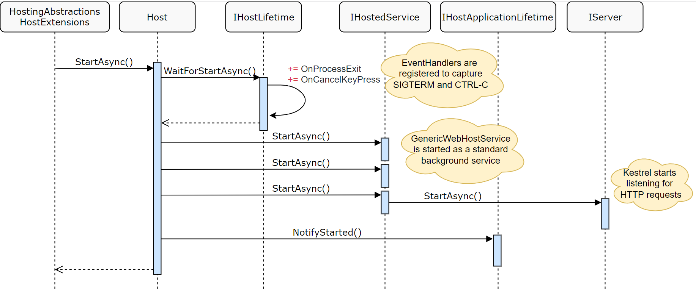
Hosting Startup ASP .NET core

Slide 12
StopAsync –
Called when host is doing graceful shutdown (ctrl + c / SIGTERM).
StopAsync’s CancellationToken has 5 seconds to shutdown gracefully.
StopAsync might not be called if app shuts down unexpectedly.

Slide 13
Hosted Services Demo

Slide 14
Background Service .NET core
This is an abstract class also implementing the IHostedService interface.
Benefit of inheriting this class is we don’t need to explicitly implement StartAsync and StopAsync (but we optionally can).
To execute tasks in this class we override the ExecuteAsync method.
Lifetime of HostedServices is singleton.
Uses same extension method services.AddHostedService<T>() to register in the IoC container.

Slide 15
When do I use a Worker Service template in Visual Studio ?
When you want an out of process way to run background tasks.
When you want to host background service out of the .NET core web application.
IIS application pool recycles every 29 hours in Azure App Service/On premise.
IIS requests are inactive after 20 minutes of inactivity.

Slide 16
Will the ExecuteAsync method run in its own thread ?
If ExecuteAsync is marked with async keyword.
When we reach await keyword the current execution is parked, and the current thread is released back to the thread-pool for reuse.
When the async method returns, a new thread is pulled out from threadpool and execution is continued.

Slide 17
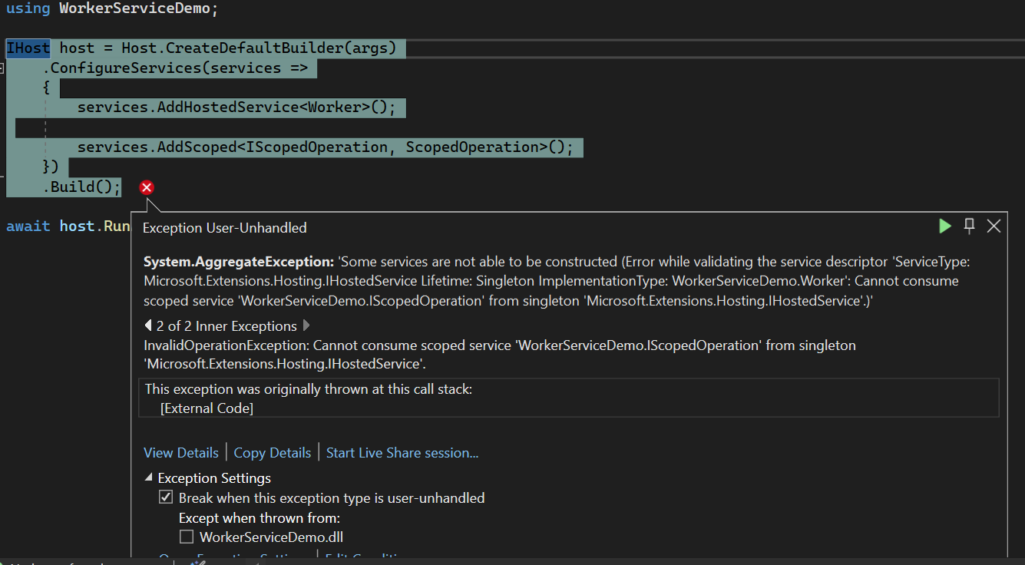
Can scoped services be injected in HostedServices/BackgroundServices ?
Injecting scoped services into HostedServices/BackgroundServices causes the following exception.

Slide 18
To mitigate that issue –
We need to inject IServiceProvider interface.
Create an artificial scope.
Get the required service using ServiceLocator pattern.
And invoke the scoped method.
Note: We can inject Singleton or Transient registered objects.

Slide 19
How can Background Services be deployed ?
By using Azure WebJobs.
By using Azure container registry and Azure Kubernetes Services.
By deploying it as Windows service in Azure Windows Server VM.
By deploying it as Linux daemon using systemd process in Azure Linux VM.

Slide 20
Deploy Background Service as Windows Service
To install Background Service as a Windows service -
Microsoft.Extensions.Hosting.WindowsService
Publish as folder, the background service.
To register our background service executable in Windows service, execute following admin command prompt.
sc create BackgroundServiceDemo binpath=“”
To run our windows service -
Go to Services.msc and search for BackgroundServiceDemo and click start

Slide 21
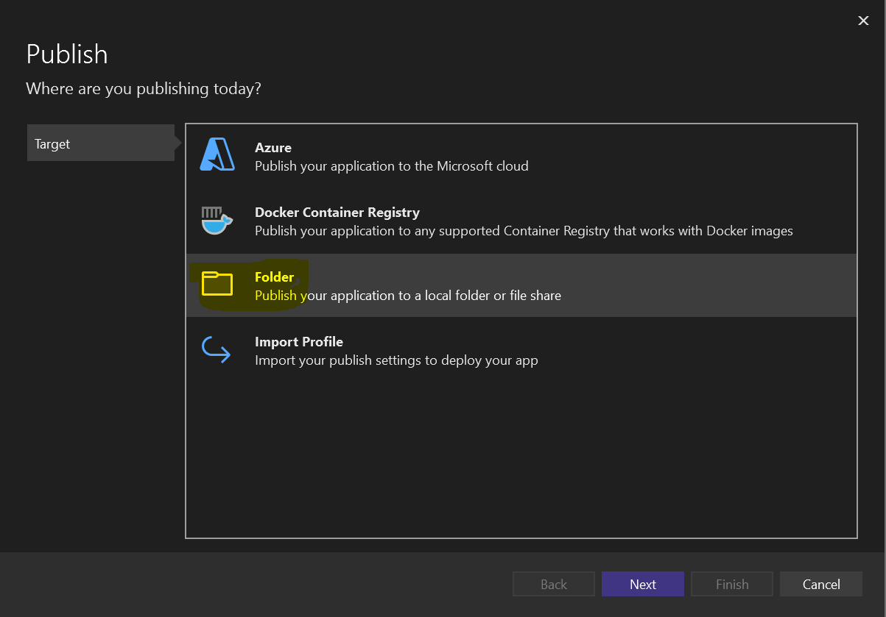

Slide 22
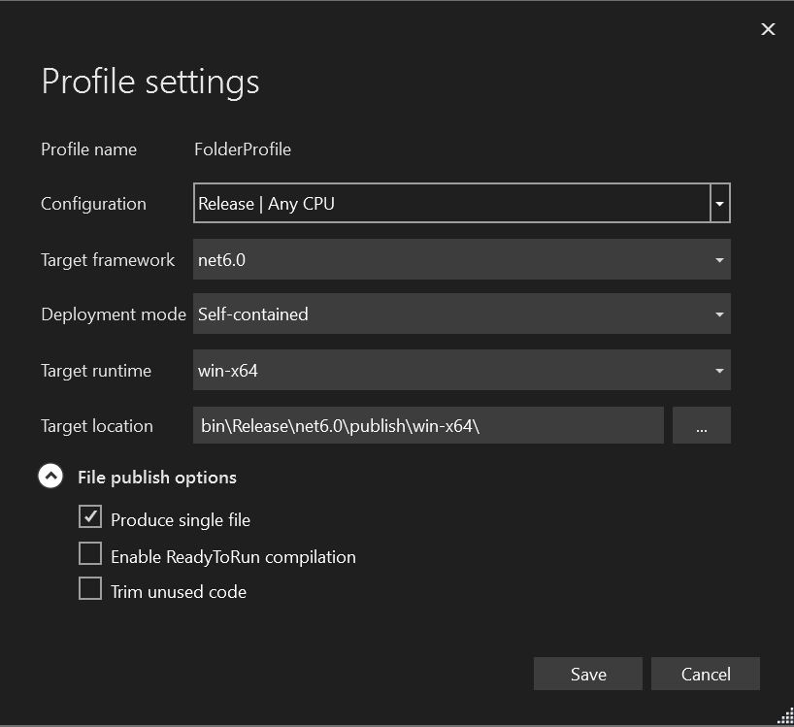

Slide 23
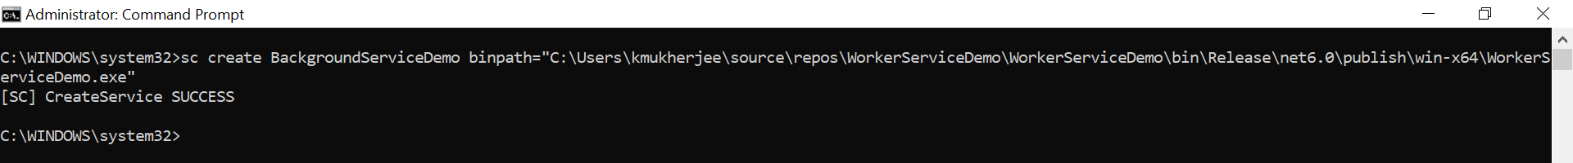
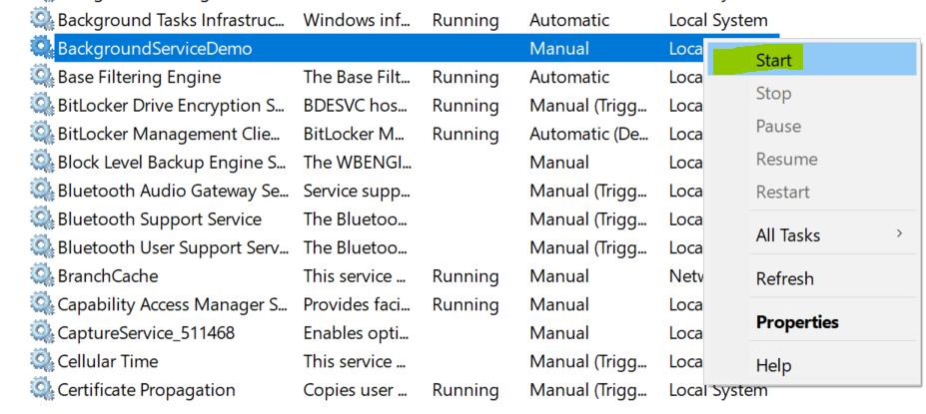

Slide 24
Background Services Demo

Slide 25
Azure WebJobs
Extension of Azure App Service.
WebJobs allow long running processes to be ran in background.
Can be utilized if having existing App Service Plan (ASP).
Only available in App Service on Windows. (No support for App Service with Linux)
Good for use cases where non-HTTP apps which need to be managed instances.
Supported file types are – .cmd/.bat/.ps1/.sh (Scripts), .exe (Executables), .php (PHP standalone scripts), .js (Node.js standalone scripts), and .jar (Java archive).

Slide 26
Azure WebJobs Triggers
Triggers can be continuous or triggered.
Continuous | Triggered
Started immediately when created. | Started only when triggered manually or via a CRON expression.
Scales out and runs on App Service instances, can be configured to run only on one instance. | Only runs on single instance, can’t scale out.
Supports remote debugging. | Doesn't support remote debugging.
Code is deployed under \site\wwwroot\app_data\Jobs\Continuous. | \site\wwwroot\app_data\Jobs\Triggered

Slide 27
Only 2 types of triggers. Hence, its use case is limited.
Suitable for simpler background processing like one-off simple scripts that need to run periodically.
For more complex business logic and triggers consider using Azure Functions / .NET Core Background Service.

Slide 28
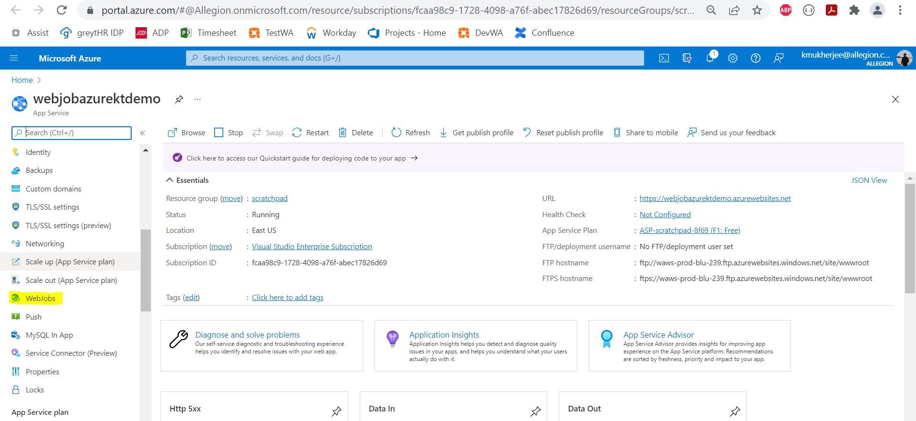
We can create WebJobs using Azure portal or Visual Studio.
To create using Azure portal navigate to Settings > WebJobs

Slide 29
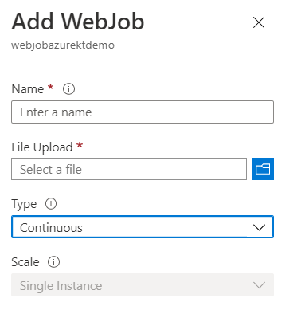
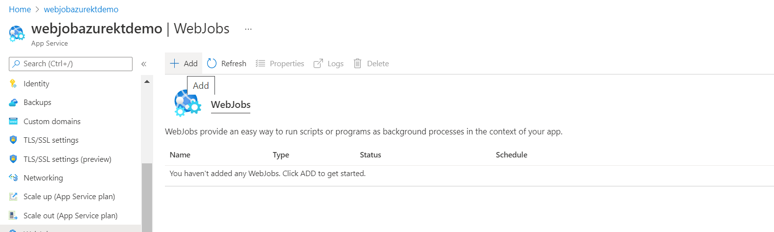

Slide 30
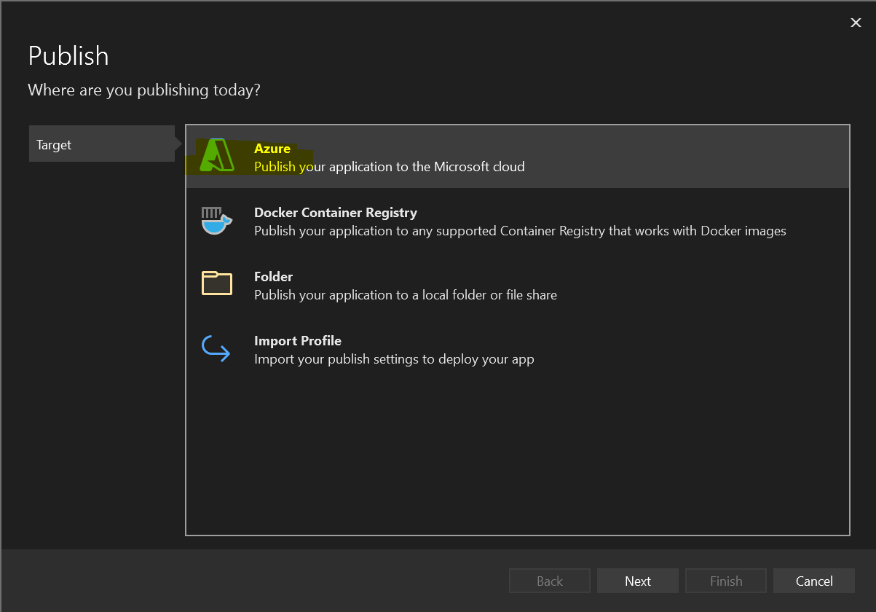
To deploy using Visual Studio right click on the project and click Publish the following wizard will appear.

Slide 31
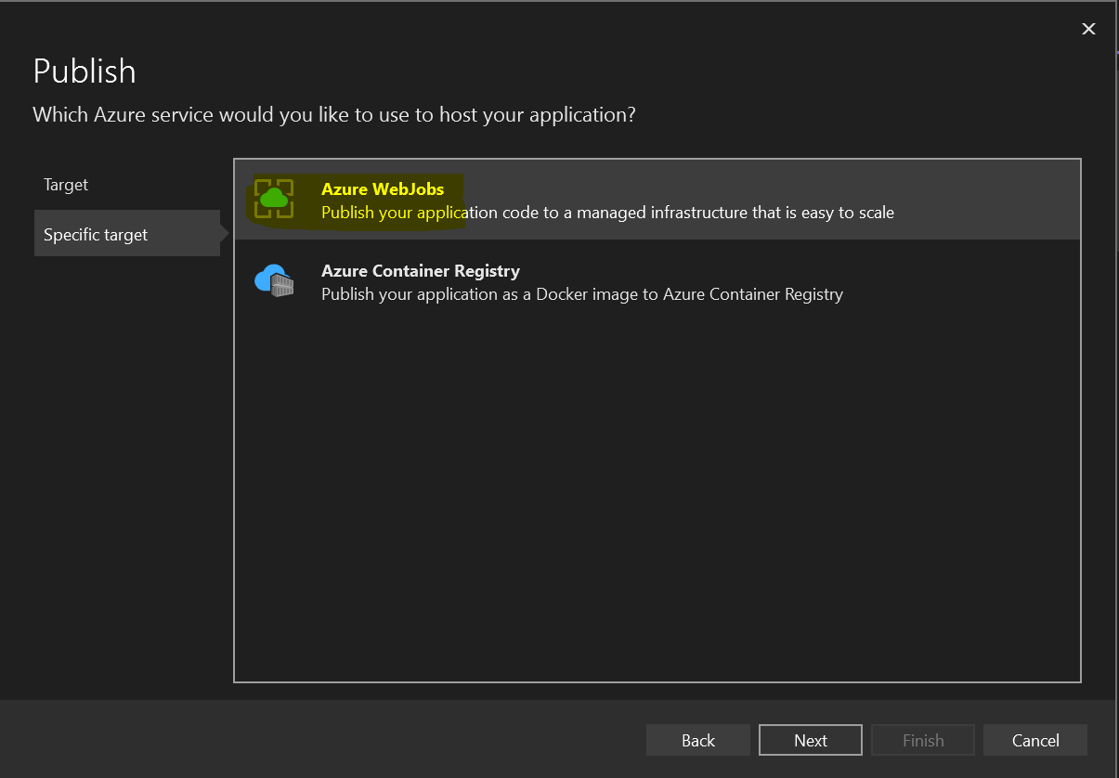
Select Azure WebJobs option

Slide 32
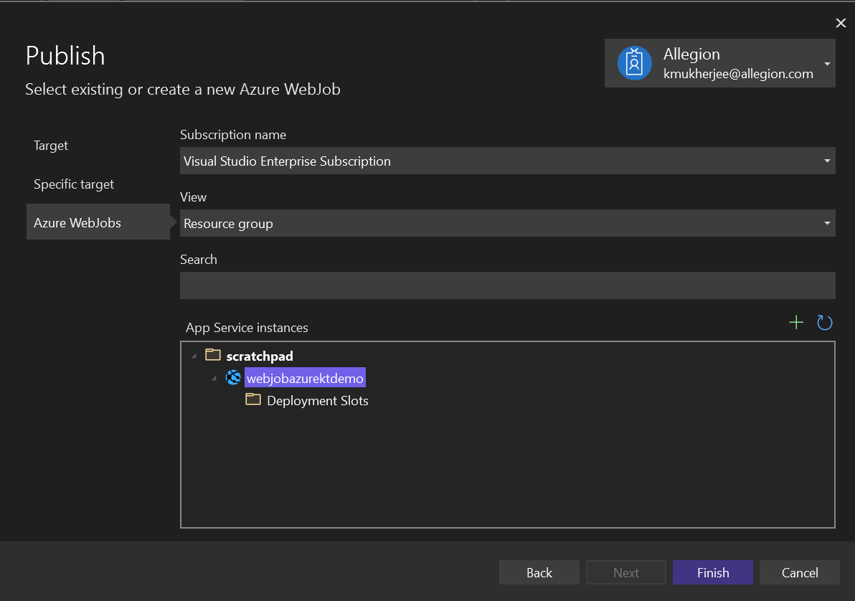
Input your Subscription and Resource Group

Slide 33
Azure WebJobs demo

